Slide 1
GCSE Options
What pathway should I choose?

Slide 2
What you must do first!
Look at the prospectus. http://www.stlouis.org.uk/options.php
Read page 1 of the options sheet
This details
  The difference between the green and purple pathways
  What all students MUST take
  Combinations of subjects that are not allowed
Notes:
Before you make any decisions, please look at the prospectus, on the school website, read page1 of the options sheet and understand the difference between the green and purple pathways. And what all pupils MUST take, and the combinations of subjects that are not allowed.

Slide 3
Subject combinations that are not allowed
You can only choose one “IT” option – the OCN NI Level 2 in IT OR GCSE Digital Technologies (Multimedia) OR GCSE Digital Technologies (Programming).
You can only choose one “Business” option – The BTEC in Business OR GCSE Business
You can only choose one “Food” option – Occupational Studies Contemporary Cuisine OR GCSE Food and Nutrition.
You can only choose either Travel and Tourism OR Geography.
All subjects offered are GCSE unless marked as “Level 2” which have GCSE Equivalencies.
Universities may not accept Occupational Studies or some Level 2 courses as equivalent to a GCSE, though they will consider it as part of your academic profile.

Slide 4

Scenario 1
Jane is doing well in Junior school. She does well in class tests and exams. She is averaging somewhere around a B grade in all her subjects.
Jane really enjoys creative subjects such as Art, she has an interest in Science and enjoys learning about the human body and she likes History.
Jane isn’t sure what she wants to do when she leaves school, but she does have an interest in nursing or social work.
What pathway should she choose?
What subjects should she choose?

Slide 5
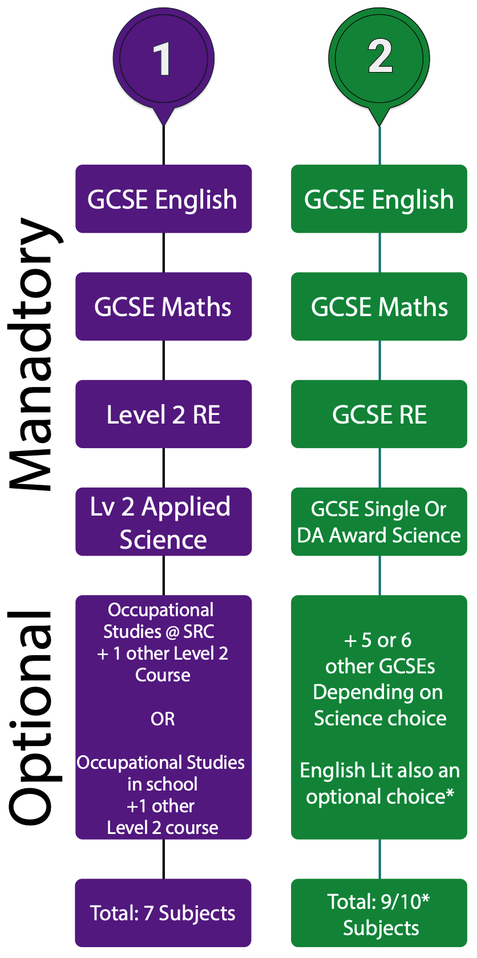
Page 14 of the prospectus has a good side by side comparison of the differences between the purple and green pathway
If Jane wants to become a nurse or work in social care, she would be advised to chose the green pathway
In the green pathway Jane can choose single or double award science.
In the purple pathway she can only do Applied Science.
Will that be enough to help her become a nurse? Ask Mrs Devlin!!!

Slide 6
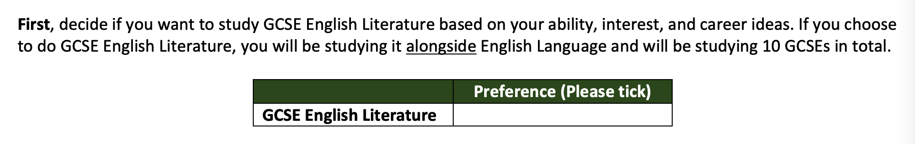
Green pathway it is!
So Jane, after getting advice, has decided that the green pathway would best meet her needs.
She now has to make her next choice. Should she do English Literature?
Jane talks to her English teacher, Miss King, and Miss King advises her that she might find English Literature difficult.
Particularly as Jane would be studying a total of 10 subjects which she might struggle with. Jane makes her CHOICE and leaves this box blank.
Notes:
Options is about choices – not all pupils will be able to get the options they want – they will have to make choices.

Slide 7
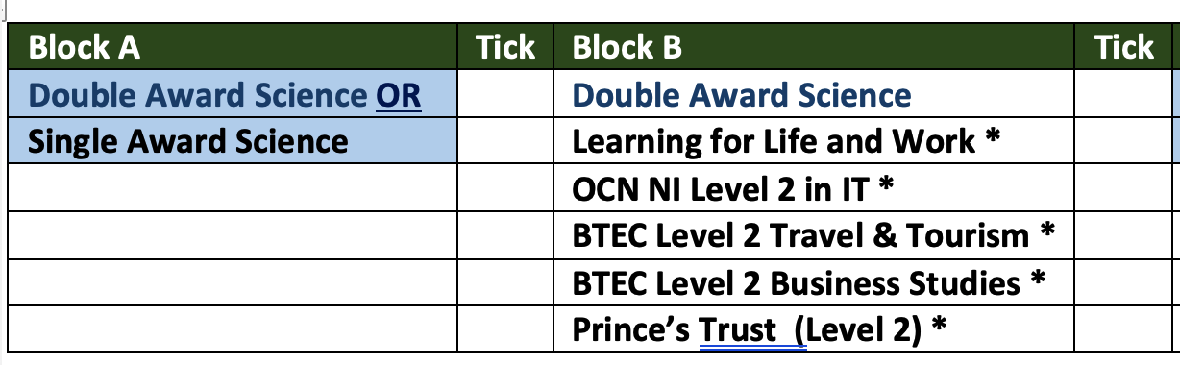
Science Choice – DA or SA Science?
Jane next looks at the science choices. She has to choose between Single Award OR Double Award.
✓
✓
After speaking to Mr Jordan Rafferty, Jane has been advised to pick Double Award Science. Jane enjoys the subject and is willing to work hard! Jane puts a tick in both Block A and B as DA Science is 2 GCSEs.

Slide 8
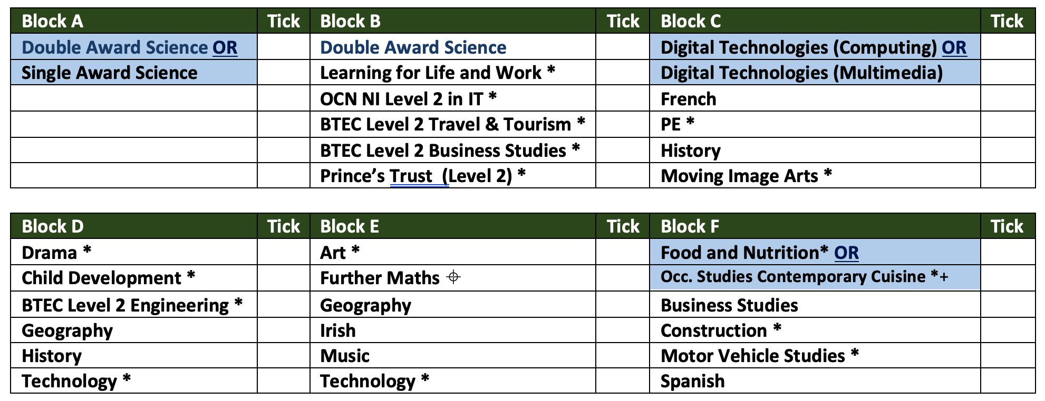
four More Choices!
Jane now has to make four more choices.
She chooses the following…
✓
✓
✓
✓
✓
✓
Notes:
Jane picks a wide variety of subjects which represents her interests, and which are subjects she feels she can do well in.
They are a mix of subjects that are 100% exam, or a mix of coursework and exam. She finds the information out in the online GCSE prospectus.

Slide 9
Coursework Vs Exam
Double Award Science – 6 exams! A little bit of practical work
Child Development - 60 % Exam, 40% Coursework
Occ. Studies Contemporary Cuisine – 100% practical / coursework!
✓
✓
✓
✓
✓
✓
Notes:
Go through the prospectus and find out the % coursework to % exam – some examples on screen.
She signs the sheet and hands this in to Mr Brown

Slide 10

Scenario 2
John has a keen interest in construction. He hopes to get a plumbing apprenticeship when he leaves school at 16
John likes to be active, and he enjoys practical subjects, he is a quick thinker but does not like writing essays
John finds studying for exams challenging and he prefers to complete and hand in homework
John isn’t sure which pathway is right for him.
Can you suggest a pathway?

Slide 11
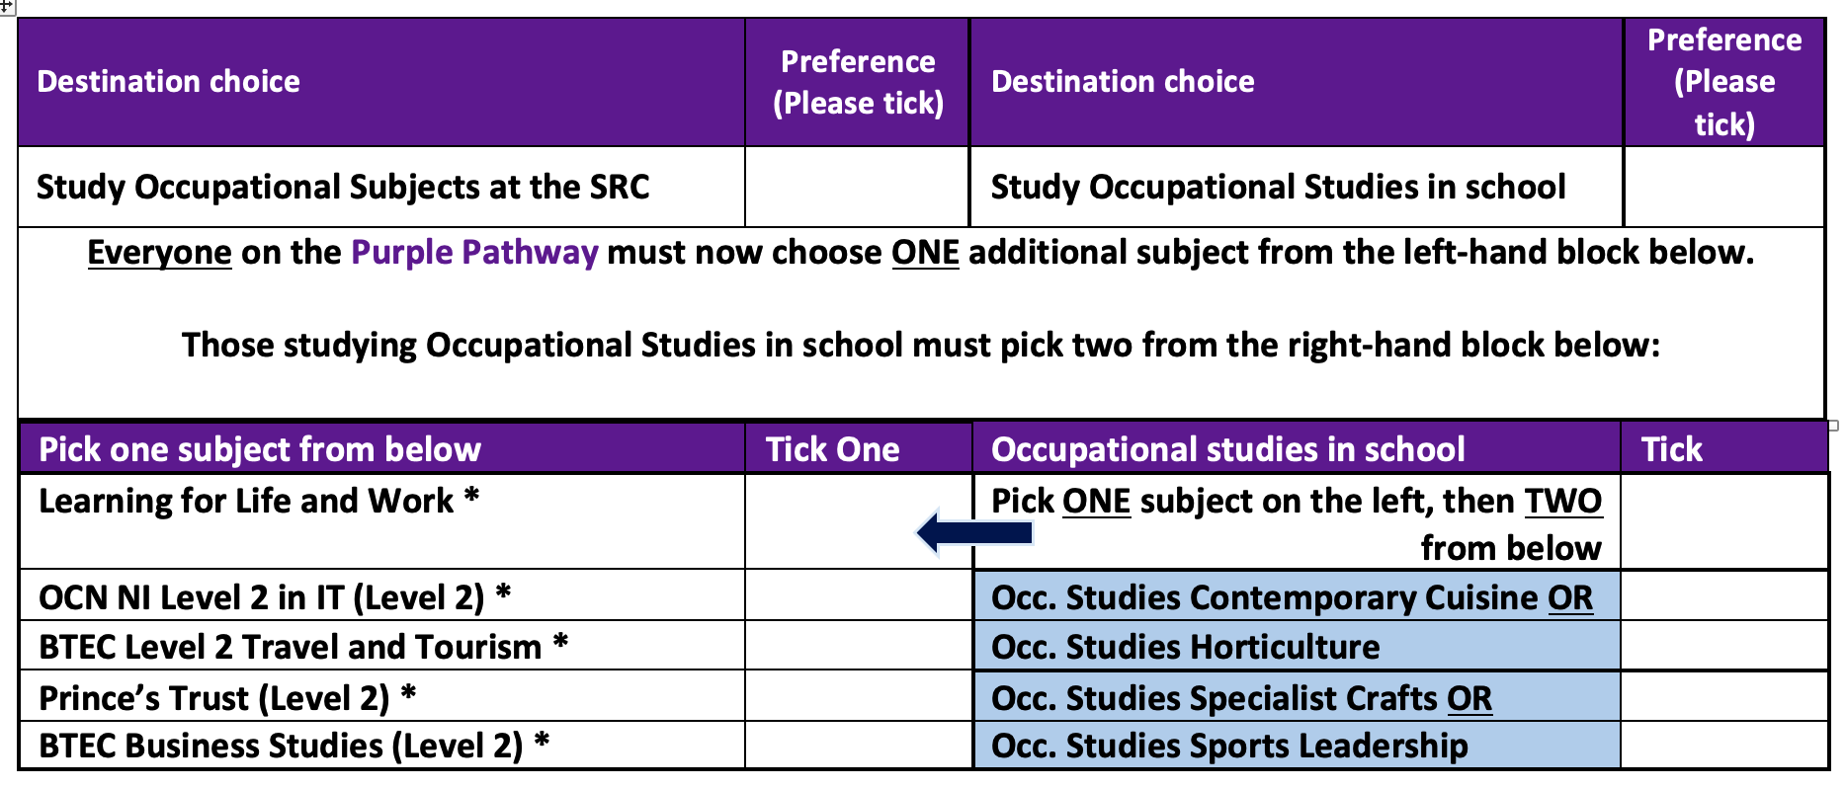
Purple Pathway
Having looked at the two pathways, John decides that the Purple Pathway would be the best choice for him. He wants to be a plumber and can only get that option at the SRC.
✓
✓
He ticks the left hand block. What does John have to do next?
He has to choose from the left hand side of the table. Which option will he study?
Notes:
John wants to be an electrician. He has spoken to Mrs McGarry and she has told him about the all the different topics you can cover in Prince’s Trust and that it is a very practical subject. If he works hard, he might even get two GCSEs out of it.

Slide 12
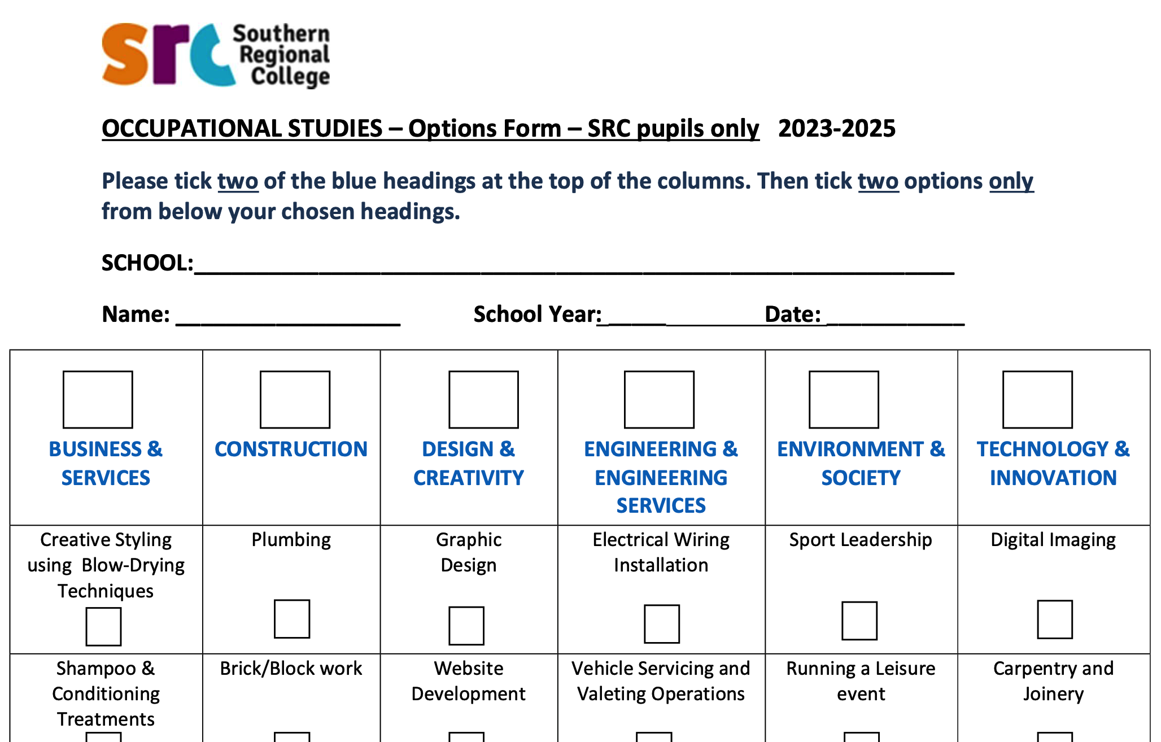
SRC Sheet
Now John has decided to go to the SRC to study different trades, he needs to complete the SRC sheet.
The SRC sheet is ordered in “headings” at the top (these are the GCSEs he will study). Below this are the individual subjects he may choose.
He looks down the list of subjects below each heading.
He decides to do Construction and Engineering & Engineering services.
✓
✓

Slide 13
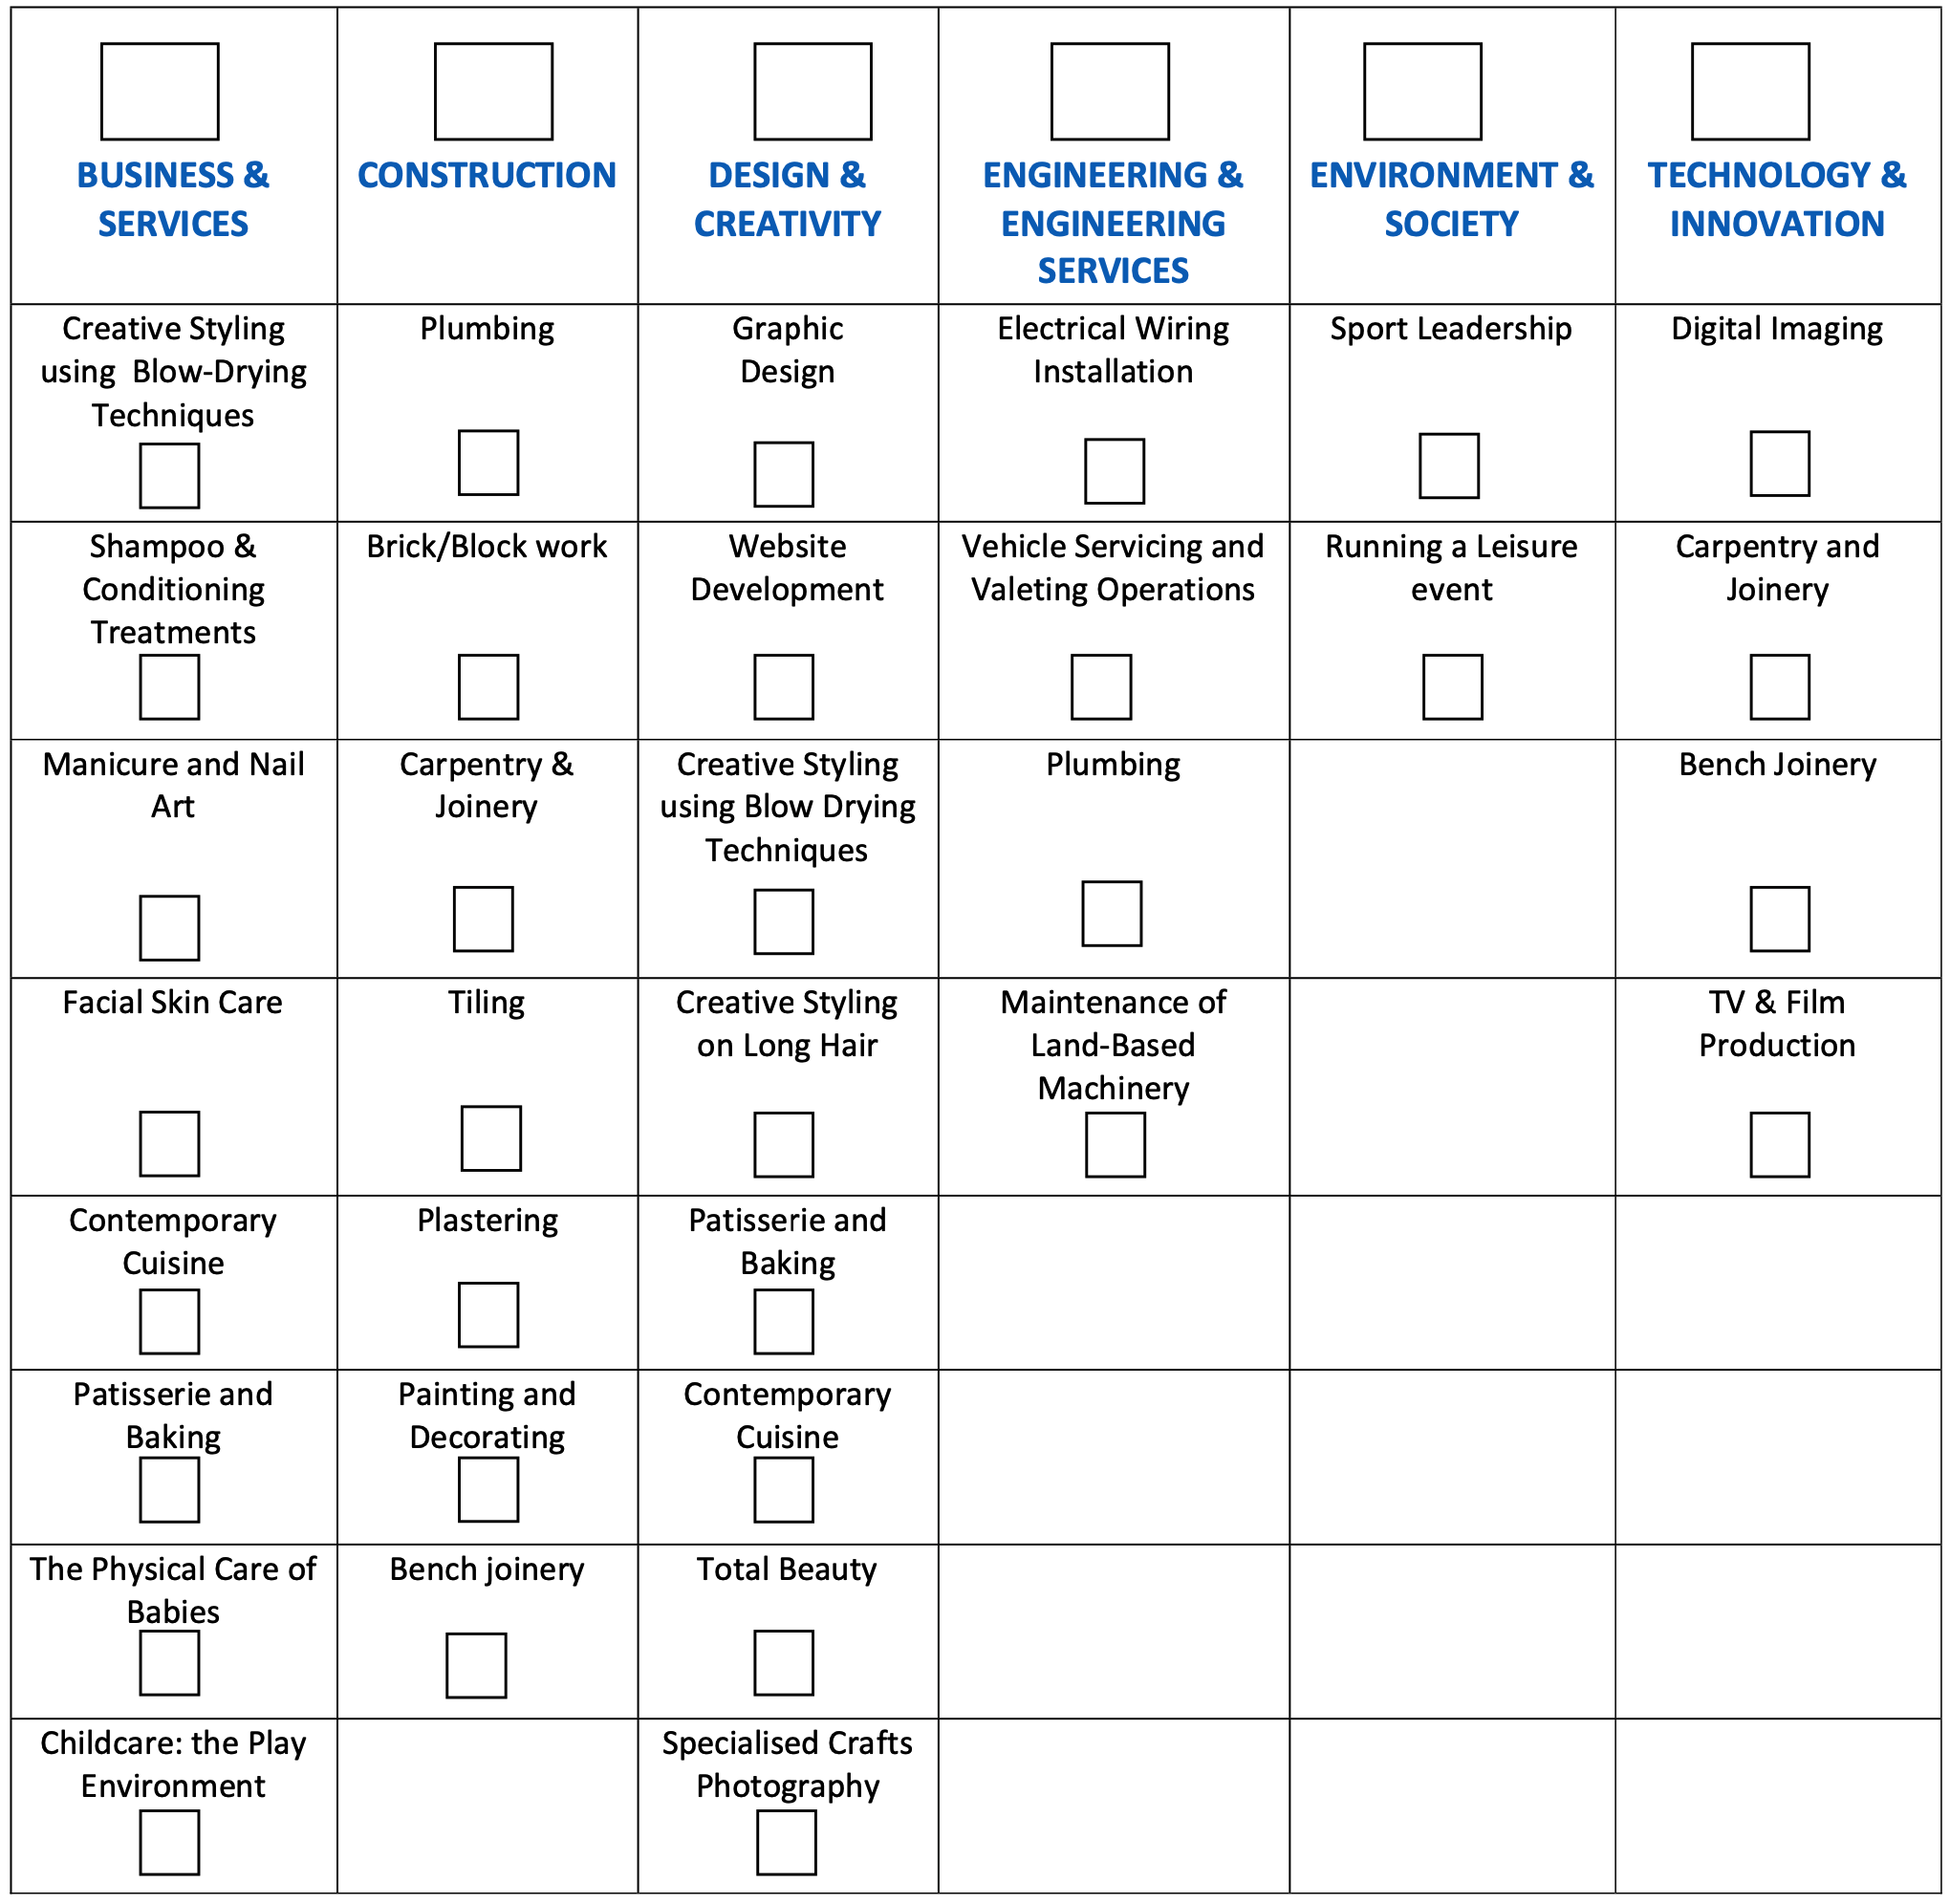
SRC Sheet
Now John has to choose two subjects under the headings. He will study two subjects in year 11, and two subjects in year 12, to equal two GCSEs overall!
✓
✓
✓
✓
✓
✓
Notes:
John will get to try out four different trades in total! This will help him to decide which he enjoys the most and what he might study post-16.
He gives BOTH options sheets to Mr Brown
Mr Brown passes the SRC sheet to the SRC so they can no start doing their options.

Slide 14

Scenario 3
Peter enjoys school but he does struggle at times with English and Maths. He likes some of the Science topics but has not been achieving well in his science tests.
Peter really likes PE as this subject is active and doesn’t have too much written work. He is interested in fitness and health.
His grades are improving in class, and he is not
sure
what to choose for his GCSE options.
He has no idea what to choose
What pathway should he choose?
What subjects?

Slide 15
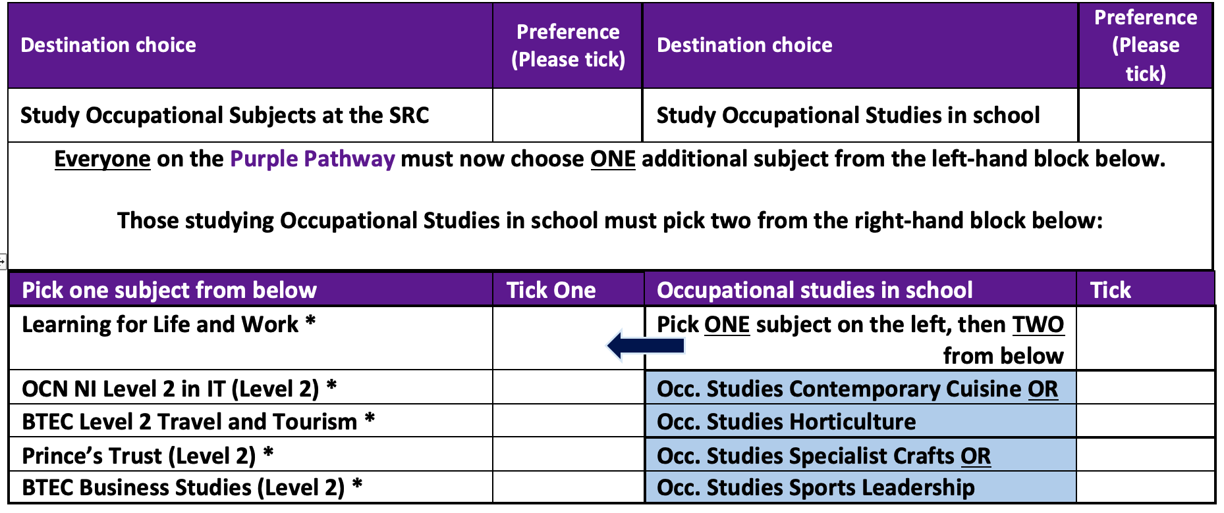
Green or Purple?
Firstly, Peter looks through the prospectus and looks at all the subjects he can do in school, or out of school at the SRC. He talks to his mum and older brother about what they think would suit him.
After attending the year 10 options day with his mum, and talking to his teachers, he is leaning towards the green pathway as he feels he will do better doing 7 GCSEs rather than 9. He doesn’t want to go to the SRC.
SOLUTION! Considers Occupational studies route in school
✓
✓
✓
✓
Notes:
His next step is to choose one subject from the left hand side. He likes the idea of a BTEC – one exam and the rest coursework – and he is interested in Business Studies.
As he is doing occupational studies in school, he then must pick one subject from the top on the right hand side of the table, then one subject from the bottom on the right hand side.

Slide 16
We are all different!
As you can see from the three examples, each pupil chose very different subjects.
Each of you is an individual.
You need to think long and hard about what pathway and subjects will suit you.
Don’t worry about what others are thinking of doing, be selfish and think only of yourself.

Slide 17

What should you do now?
Look through the prospectus
Talk to family, teachers, and more teachers!
Consider what will best suit you. Not what others are thinking of doing.
Choose your pathway
Choose your options within that pathway
If still not sure talk to Mrs Devlin or the careers advisor.
If you are not sure about the process, talk to Mr Brown!
We look forward to seeing you and your parents on 30th of January.

Slide 18

Any Questions?

